Slide 1
Mottled Stars
How Does Starspot Coverage Affect Stellar Brightness Variability?
Miles L. Johnson

Slide 2
WHAT IS A STARSPOT?
Starspots are dark blotches on the surface of stars (Gough 2010).
First studied in the west when Galileo Galilei and Thomas Harriot first used telescopes to observe the Sun (Gough 2010).
Their causes and affects on their host star are not well understood.
Thought to be caused by magnetic disturbances beneath the stellar surface (Gough 2010).

Slide 3
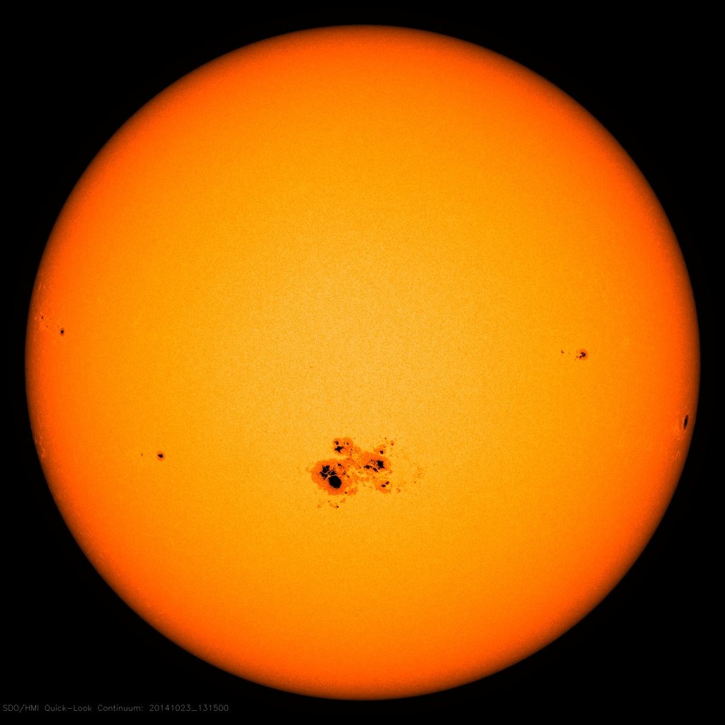
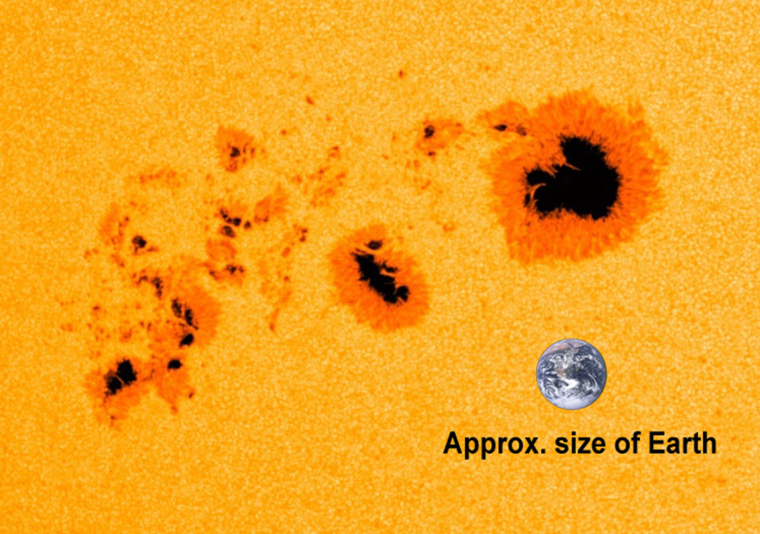
Sunspots
Image Credit: NASA/SDO
Image Credit: NASA/SDO

Slide 4
MOTTLED Stars project
Continuing a project dubbed Mottled Stars
In 2018, Dr. Feiden worked with first-year undergraduate Amanda Ash
Title: Mottled Stars: Improving Age Estimates for Young Stars in the Planet Formation Era
Their Findings:
Showed (maybe for the first time) that starspots might just be transient features on the surface of some stars

